Slide 1
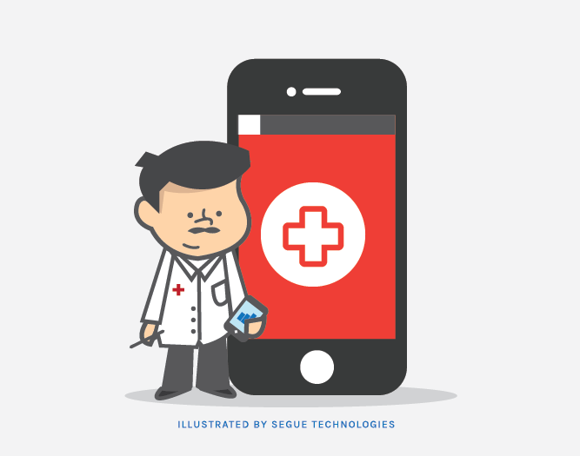
Urgent Healthcare Solutions
Group 17:
Anay Dutta
Anisha Vijayan
Saloni Kataria
Sravya Chouta

Slide 2
CONTENTS
01
Problem
02
Statement of Work
03
Deliverables
04
Risks
05
Project Plan
06
Data Sources
07
Progress & Teamwork

Slide 3
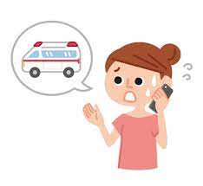

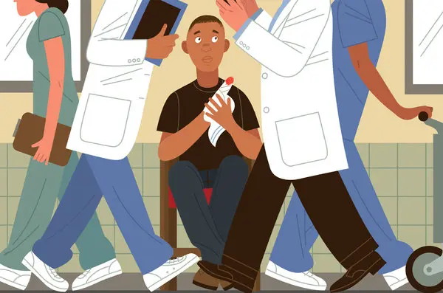
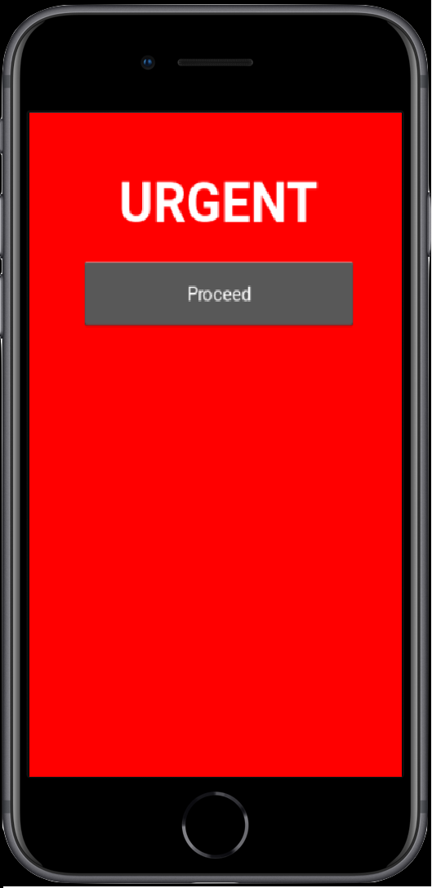
Problem
You’re in need of urgent care,
you’re panicking,
you can’t think straight,
and need to go to an urgent care facility.
Call someone or look for an urgent care on google
You go to an Urgent Care nearby and find out you’re going to be waiting an hour.
If you knew the waiting time before coming, then you would have headed to another facility for immediate care, right?
That’s where our app “URGENT” comes in!

Slide 4
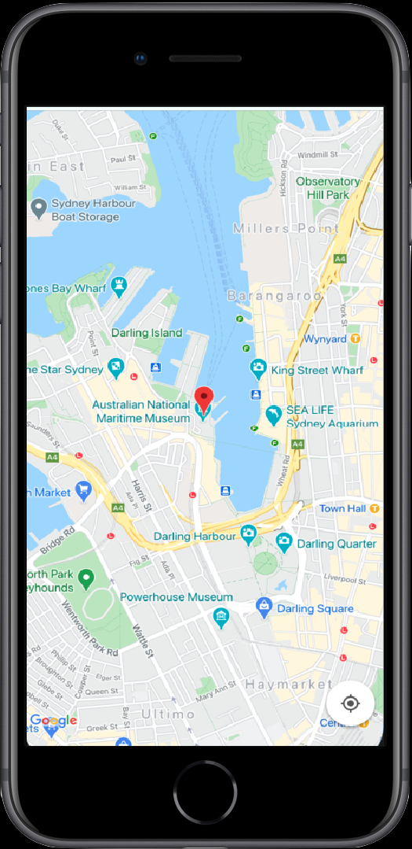
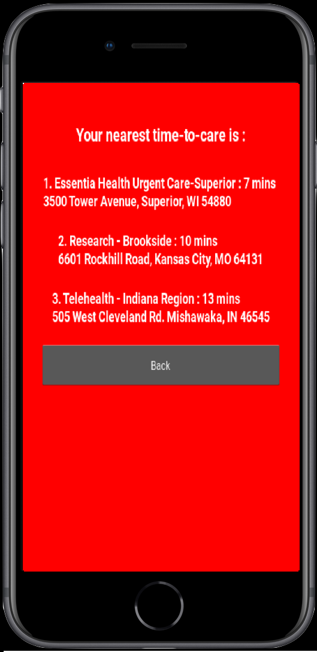
Statement of Work
Our App will recommend nearest and lowest wait time urgent care facilities based on the hospital waiting time, distance, and estimated time to arrival.
Existing solutions: calling urgent care facilities directly, looking them up on google, some facilities having online check-in and wait time on their website.

Slide 5
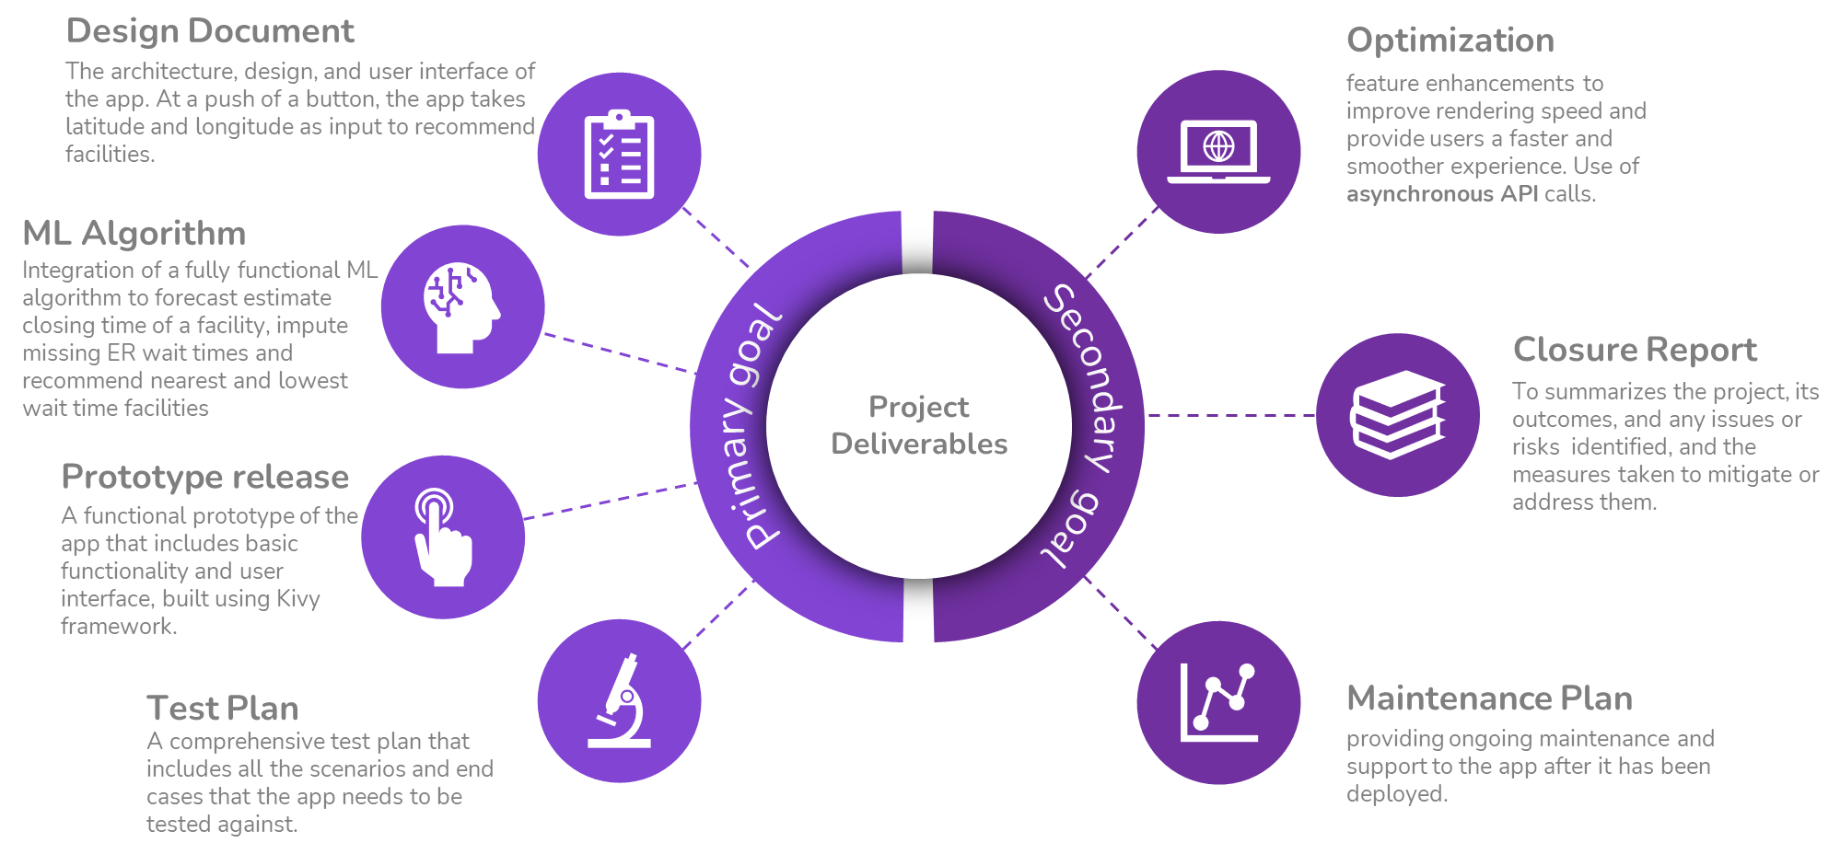
Project Deliverables

Slide 6

Risks Associated
- Technical risks related to compatibility issues and integrating various technologies
- Data quality risks related to the accuracy and completeness of the data used
- Security risks related to storing personal or sensitive information
- Legal and regulatory risks related to compliance with data protection laws
- User acceptance risks related to the app's user-friendliness and meeting target audience expectations
- Resource risks related to availability of skilled developers, budget, and equipment procurement
- Competition risks related to the highly competitive market for healthcare apps
- Compatibility: The app must be compatible with various devices.

Slide 7
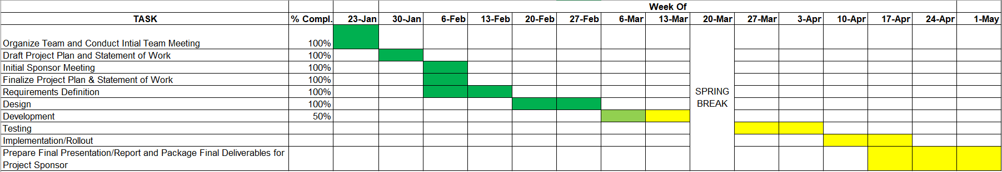
Project Plan

Slide 8
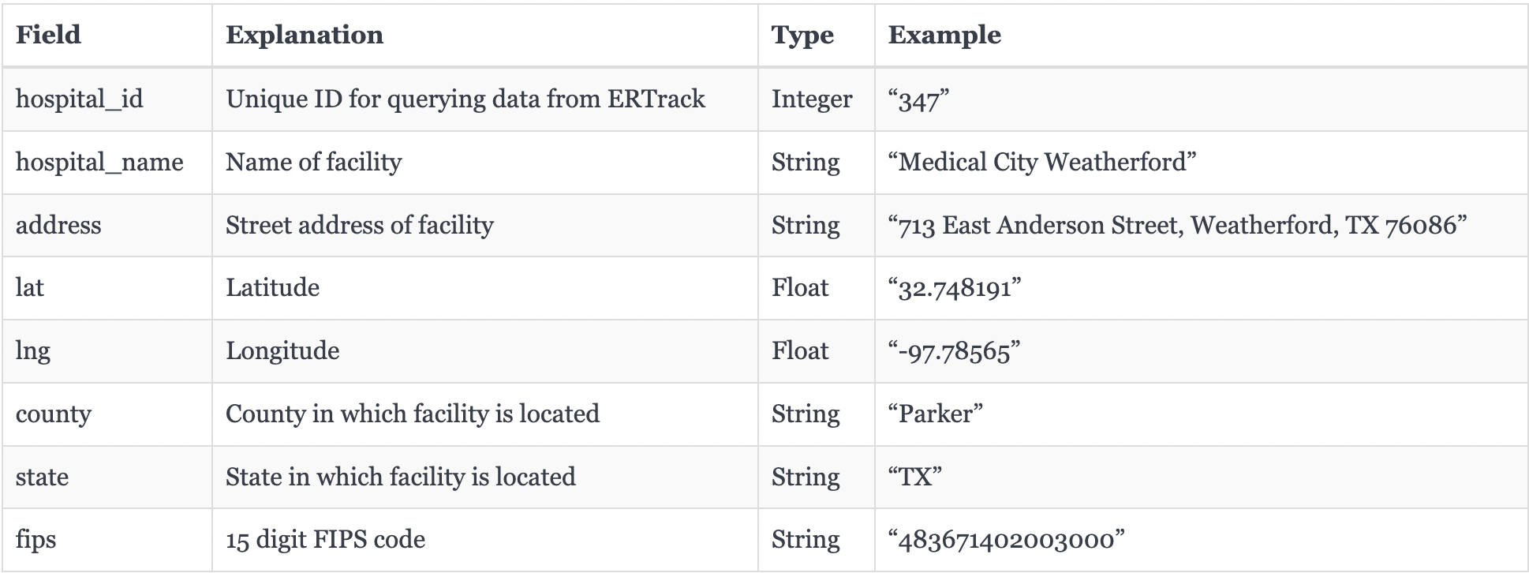
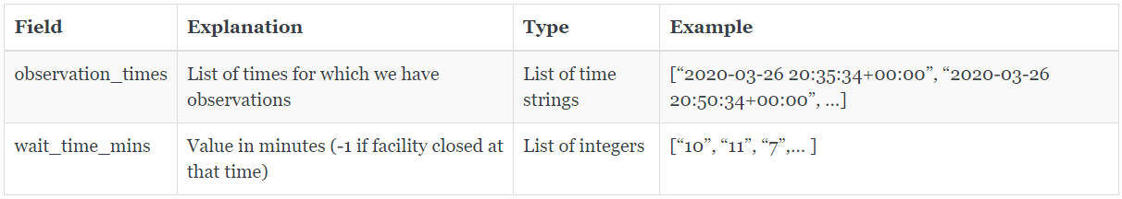
Data Sources
ERTrack.net API : https://ertrack.net/api/
To see all hospitals: https://ertrack.net/api/hospitals/
To get the wait time history of a single facility: https://ertrack.net/api/hospital/{hospital_id}/history/

Slide 9
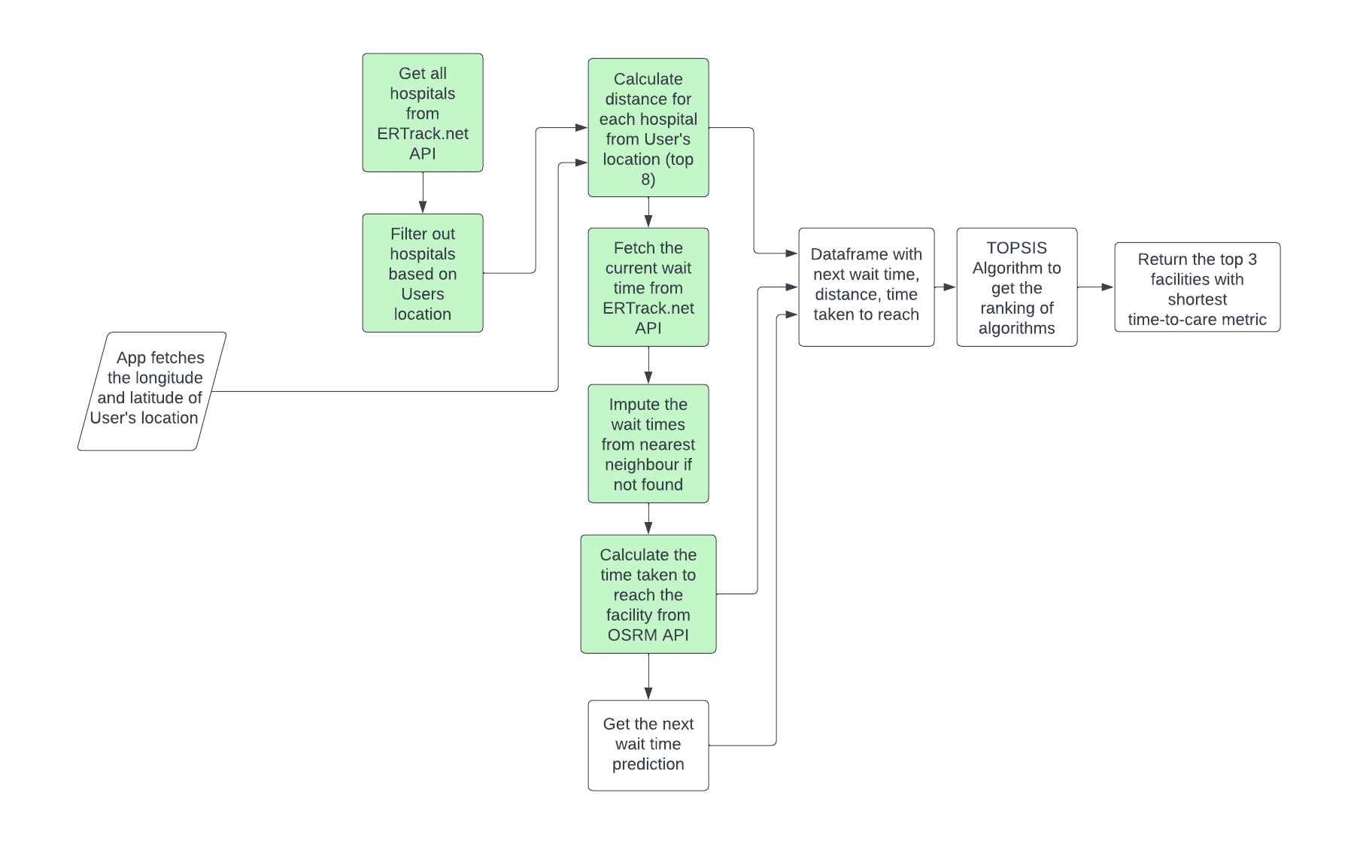
Progress
Notes:
We have designed our project.
Started the development of the app, since we still haven’t been able to start with the incorta platform certification, we have started the development using the kivy library in python.
We have been able to filter out the hospitals based on proximity of the user’s location, fetch the top 8 hospitals filtering out the closed hospitals, taking into account the commute time

Slide 10
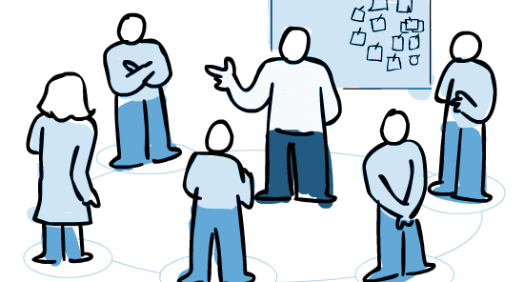
Teamwork
Daily Internal meeting
Weekly Meeting with Kim
Weekly Meeting with Poonam
Blackboard File Exchange for Files
Whatsapp group
Maintaining MOMs
& Weekly Reports

Slide 11
Questions

